Slide 1
HNDIT1212: System Analysis and Design
Introduction

Slide 2
Learning Outcomes
At the end of the module the student will be able to:
Describe different lifecycle models and explain the contribution of the systems analysis and design with in them
Discuss various approaches to systems analysis and design and explain their strengths and weaknesses
Evaluate the tools and techniques of systems analysis and design that may be used in a given context
Use appropriate methods and techniques to produce an analysis of a given scenario
Use appropriate methods and techniques to produce a system design for an given scenario
Provide suitable documentation for systems analysis and design activities

Slide 3
Outline Syllabus
Introduction to System Analysis and Design
Software development lifecycles
Requirement elicitation and business analysis
System analysis and design tools
Logical Data flow Design
System testing
System conversion
System maintenance

Slide 4
Information system
It is an arrangement of Computer Technology (Hardware & Software) and Telecommunication Technology (Data, image, voice) to support and improve day to day operations, problem solving and decision making needs of management and users.

Slide 5
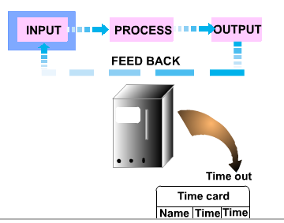
Main components of an Information System
Information systems consist of four main components.
They are,
Input (collects data)
Processing (process data)
Output (disseminates data)
Feedback

Slide 6
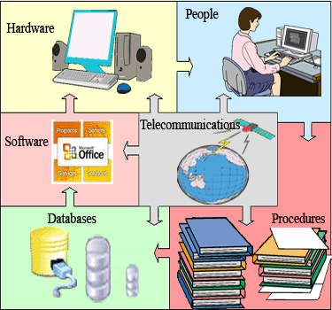
Computer Based Information Systems(CBIS)
The resources of a CBIS include,
hardware
software
databases
telecommunications
people
procedures

Slide 7

System development environment
Stakeholders
Any person who has an interest in an information system and its outputs.
Mainly, there are five types of stakeholders.
Systems User
Systems Owner
Systems Builder
Systems Designer
Systems Analyst

Slide 8

Systems User
A “customer” who will use an information system by,
capturing
validating
entering
responding to
storing
exchanging
data and information on a regular basis. A common synonym is client.
Systems users define the business requirements and performance expectations for the system to be built.

Slide 9

Systems Owner
Systems owner is an information system’s sponsor and advocate and he owns the final system.
They pay for the system to be built and maintained .
They set the vision and the priorities for the system and determine the policies for its use.
Responsible for funding the project of
Developing
Operating
Maintaining the information system.

Slide 10
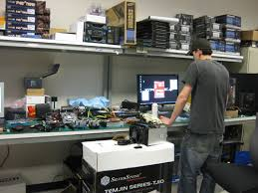
System builder
System builders are technical specialists involved with
Constructing
Testing
Delivering the system into operation
They construct the information system components based on the design specifications from the system designers.

Slide 11

Systems Designer
System designers are technical specialists
Translate systems users business requirements and constrains into technical solutions
They design the system including
Databases
Inputs
Outputs
Screens
Network
Software to meet the users requirements

Slide 12

Systems Analyst
System analysts are people who understand both business and computing

Slide 13
Role of system analyst
Identify the problem
Analyze and understand the problem
Identify the solution requirements
Identify alternative solutions
Design and implement the best solution
Evaluate the result

